Slide 1
Aramco Fleet Model
Xin He, Jinghui Wang
Aramco Americas – Aramco Research Center Detroit
Dec, 2024

Slide 2
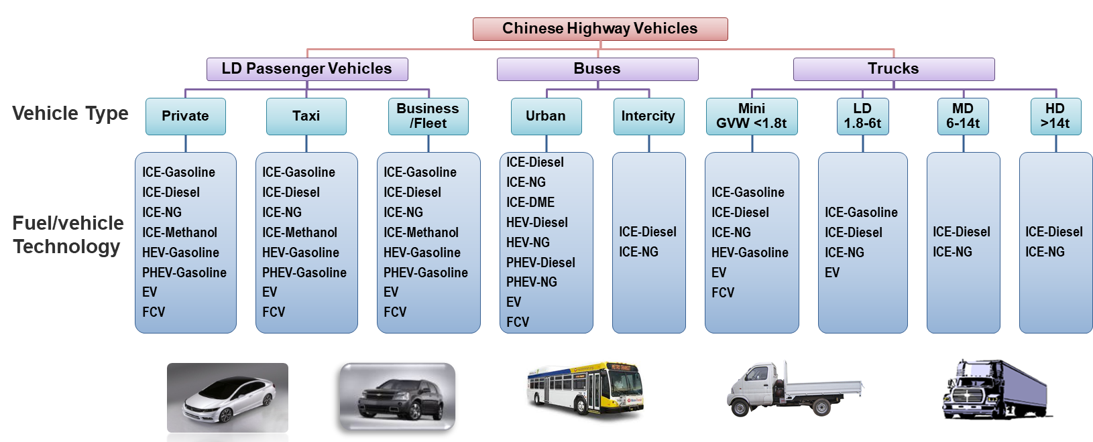
China Fleet Model Structure
Historical data is critical to understand the characteristics of the fleet.
Notes:
Hydrogen is a key element that enables clean-energy pathways across various sectors. This slide is divided into two parts: production and end-use.
On the left side, we have the production of hydrogen. Hydrogen can be produced through various methods, including electrolysis using green electricity, and steam methane reforming or methane pyrolysis with CCS.
On the right side, we see the end-use applications of hydrogen. For example, in transportation, synthetic and e-fuels, ammonia for fertilizer, metal production, commercial and residential heat. On top of those, hydrogen’s ability to store energy makes it a valuable solution for balancing the intermittent renewable energy sources like wind and solar. And it does not require a ton of critical minerals.

Slide 3
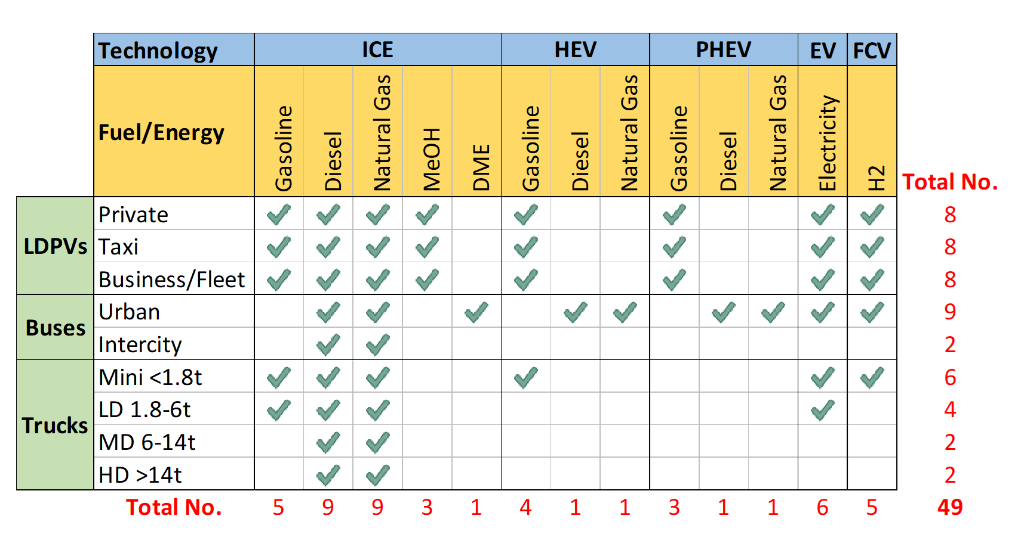
Detailed Vehicle Type/Technology/Fuel Combinations
49 vehicle technology/fuel combinations
5 powertrain types
27 ICEVs, 6 HEVs, 5 PHEVs, 6 BEVs, and 5 FCVs
10 fuel/energy types

Slide 4
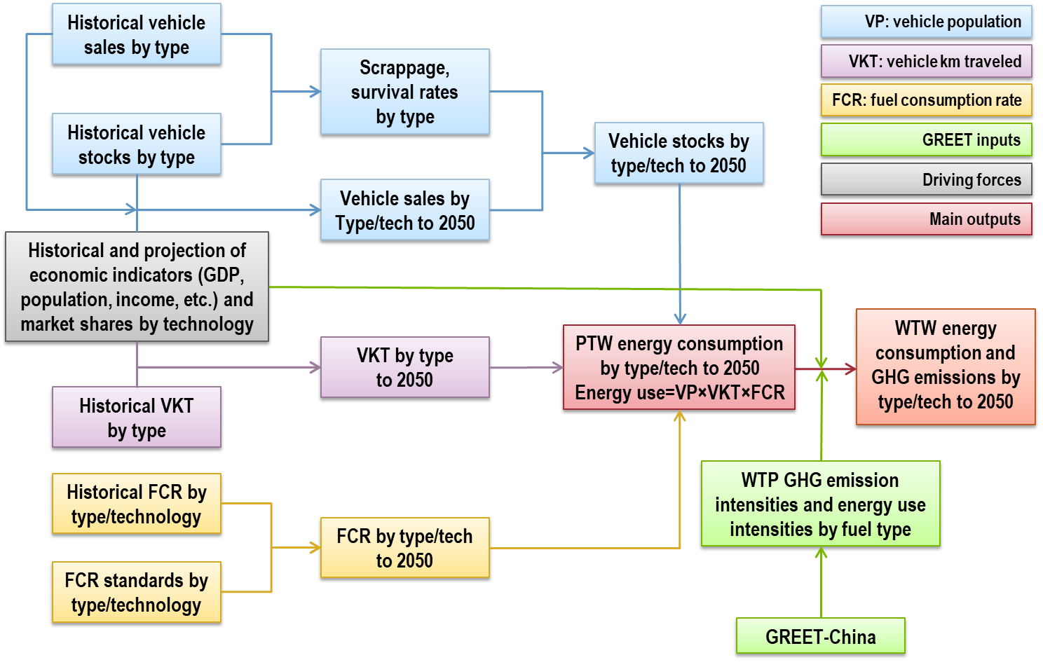
General Methodology
GREET-MENA

Slide 5
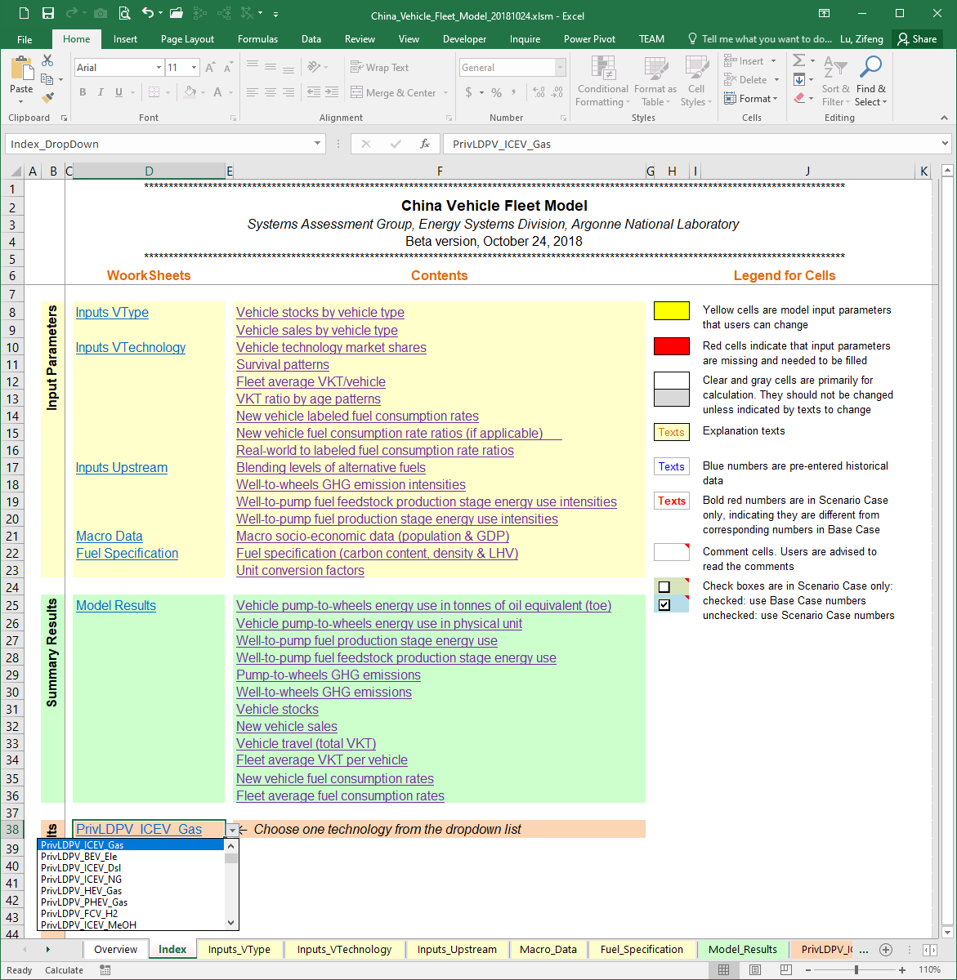
Model Structure & Interface
Overview (white tab)
A brief description of the Model
Index (light red tab) is the main user interface
Hyperlinks to all worksheets, inputs, & results sections
Color-coding for cells
5 Inputs (light yellow tabs) contain key parameters related to…
Vehicle type
Vehicle technology
Upstream
Macro socio-economic indicators
Fuel specifications, etc.
Model_Results (light green tab)
Aggregated simulation results by vehicle technology, by vehicle type, and by fuel/energy type
49 Technologies (orange tabs)
Detailed fleet turnover calculation processes and results for each vehicle technology

Slide 6
Data Needed (sample)
New vehicle purchase data
 | Model | Fuel type | Fuel Economy (mpg) | Expected years in service
Vehicle A | Toyota Camry LE | Gasoline | 53/50 | 5
Vehicle B | Toyota Tocama SR5 | Gasoline | 20/26 | 10
Vehicle C | Bus xxx | Natural gas | 12/15 | 6
Vehicle D | HD Truck, Volvo xxx | Diesel | 6.5/7.5 | 10
……
Vehicle Stock
 | Model | Fuel | Category | FE | Year purchased | Year sold/ scraped | VKT (km)
 |  |  |  | pmg |  |  | 2014 | 2015 | 2016 | 2017 | …. | 2020 | 2021 | 2022 | 2023 | 2024
A | Toyota Camry LE | Gasoline | Car | 40/43 | 2015 | 2022 | 0 | 30000 | 25000 | 20000 | 20000 | 20000 | 18000 | 500 | 0 | 0
B | Ford F150 | Gasoline | Pickup | 20/26 | 2016 | 2023 | 0 | 0 | 5000 | 25000 | 24000 | 23000 | 18000 | 17000 | 6000 | 0
C | Bus xxx | NG | Transit bus | 12/15 | 2017 | 2021 | 0 | 0 | 0 | 40000 | 38000 | 25000 | 10000 | 0 | 0 | 0
D | HD Truck, Volvo xxx | Diesel | HD | 6.5/7.5 | 2016 | 2022 | 0 |  | 80000 | 100000 | 100000 | 80000 | 70000 | 500 | 0 | 0
 | …….

Slide 7
Project Timeline
Tasks | Months
 | 1 | 2 | 3 | 4 | 5 | 6
Data exploration and cleaning
Model structure identification and design
Develop Excel-based modeling tool
Model validation
Model delivery and presentation

Slide 8

Thank You!
For further information, please contact:
Xin He, Ph.D., Team Leader
Aramco Research Center – Detroit
46535 Peary Court
Novi, MI 48377 – USA
Tel: +1 248 896 3937
Email: xin.he@aramcoamericas.com

